Slide 1
Naïve Bayes

Slide 2
Prostate Cancer dataset – One field/class
P34 level | Prostate cancer
High | Y
Medium | Y
Low | Y
Low | N
Low | N
Medium | N
High | Y
High | N
Low | N
Medium | Y
It’s useful to know:
P(cancer = Y)

Slide 3
Prostate Cancer dataset - One field/class
P34 level | Prostate cancer
High | Y
Medium | Y
Low | Y
Low | N
Low | N
Medium | N
High | Y
High | N
Low | N
Medium | Y
P(C = Y) is 5/10 = 0.5
So, with no other info you’d expect P(cancer=Y) to be 0.5

Slide 4
Prostate Cancer dataset - One field/class
But we know that P34 =H,
so actually we want:
P(cancer=Y | P34 = H)
- the probability that cancer is Y,
given that P34 is high
P34 level | Prostate cancer
High | Y
Medium | Y
Low | Y
Low | N
Low | N
Medium | N
High | Y
High | N
Low | N
Medium | Y
2/3 = 0.67

Slide 5
Prostate Cancer dataset
Suppose again we know that
P34 is High;
P ( c=Y | P34 = H) = 0.5
P ( c=N | P34 = H) = 0.25
P(c = Maybe | H) = 0.25
P34 level | Prostate cancer
High | Y
Medium | Y
Low | Y
Low | N
Low | N
Medium | N
High | Y
High | N
High | Maybe
Medium | Y

Slide 6
Naive Bayes
P(cancer = Y | P34 = H)
P34 level | Prostate cancer
High | Y
Medium | Y
Low | Y
Low | N
Low | N
Medium | N
High | Y
High | N
Low | N
Medium | Y

Slide 7
Naive Bayes
And now we are illustrating
P(P34 = H | cancer = Y)
2/5 = 0.4
P34 level | Prostate cancer
High | Y
Medium | Y
Low | Y
Low | N
Low | N
Medium | N
High | Y
High | N
Low | N
Medium | Y

Slide 8
Naive Bayes
That is the essence of Naive Bayes, but: the probability calculations are much trickier when there are >1 fields so we make a ‘Naive’ assumption that makes it simpler

Slide 9
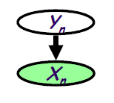
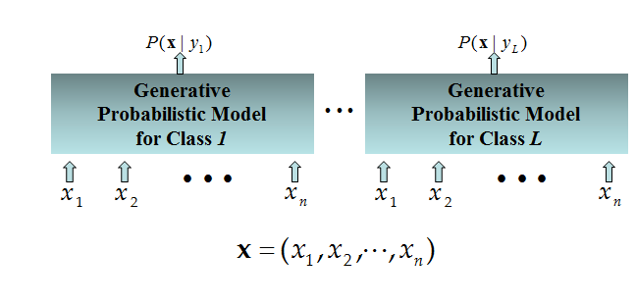
Probabilistic Classification Principle
Establishing a probabilistic model for classification
Generative model (must be probabilistic)
L probabilistic models have to be trained independently
Output L probabilities for a given input with L models
Based on joint probability distribution
Assume some functional form for P(X|Y), P(Y)
Estimate parameters of P(X|Y), P(Y) directly from training data
Use Bayes rule to calculate P(Y|X= x)

Slide 10
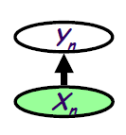
Probabilistic Classification Principle
Establishing a probabilistic model for classification
Discriminative (informative) model
To train a discriminative classifier regardless its probabilistic or non-probabilistic nature, all training examples of different classes must be jointly used to build up a single discriminative classifier.
Directly assume some functional form for P(Y|X)
Estimate parameters of P(Y|X) directly from training data
Discriminative
Probabilistic Classifier

Slide 11

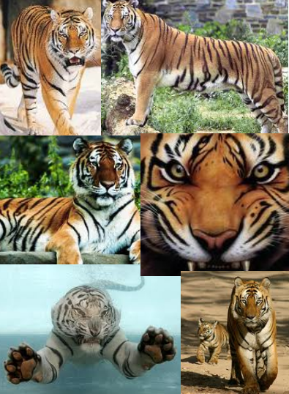
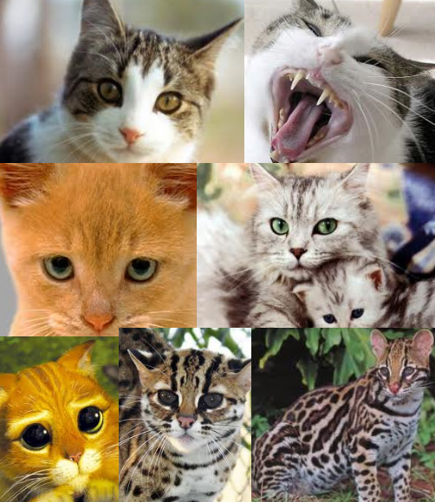
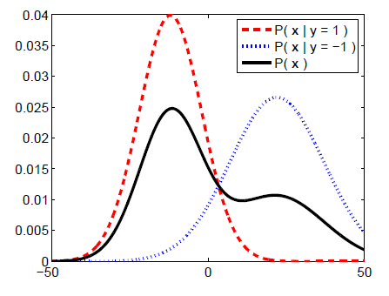
Generative Model
Color
Size
Texture
Weight
…

Slide 12
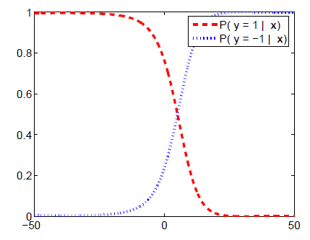
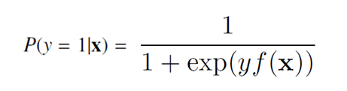
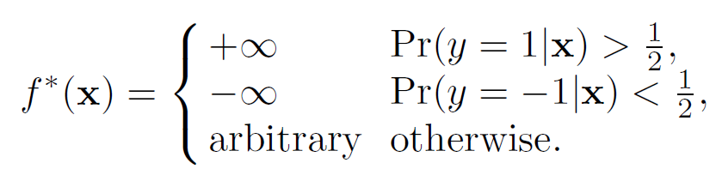
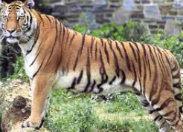
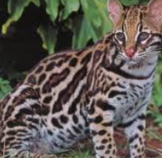
Discriminative Model
Logistic Regression
Color
Size
Texture
Weight
…

Slide 13
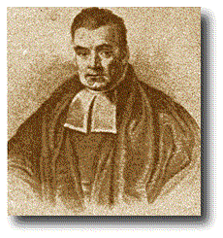
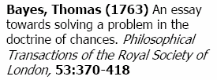
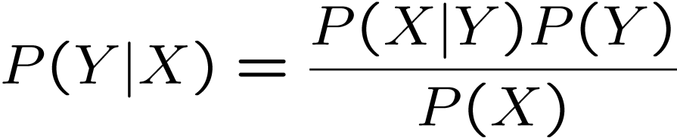
Bayes Formula
Likelihood of seeing the evidence if the hypothesis is correct
Posterior probability
Prior probability
Normalizing constant – the likelihood of the evidence under any circumstances

Slide 14
Bayes Theorem – Additional Info
Prior, conditional and joint probability for random variables
Prior probability:
Conditional probability:
Joint probability:
Relationship:
Independence:

Slide 15
Bayes Theorem
Bayes theorem deals with sequential events, whereby new additional information is obtained for a subsequent event, and that new information is used to revise the probability of the initial event.
Prior probability - is an initial probability value originally obtained before any additional information is obtained.
Posterior probability - is a probability value that has been revised by using additional information that is later obtained.

Slide 16
Bayes Theorem – Example #1
An organization randomly selects an adult for a survey about credit card usage. Use subjective probabilities to estimate the following.
What is the probability that the selected subject is a male?
b. After selecting a subject, it is later learned that this person was smoking a cigar during the interview. What is the probability that the selected subject is a male?
c. Which of the preceding two results is a prior probability? Which is a posterior probability?

Slide 17
Bayes Theorem - Example
Roughly half of all population are males, so we estimate the probability of
selecting a male subject to be 0.5. Denoting a male by M, we can express this probability as follows: P(M) = 0.5.
b. Although some women smoke cigars, the vast majority of cigar smokers are males. A reasonable guess is that 85% of cigar smokers are males. Based on this additional subsequent information that the survey respondent was smoking a cigar, we estimate the probability of this person being a male as 0.85. Denoting a male by M and denoting a cigar smoker by C, we can express this result as follows: P(M | C) = 0.85.
c. In part (a), the value of 0.5 is the initial probability, so we refer to it as the prior probability. Because the probability of 0.85 in part (b) is a revised probability based on the additional information that the survey subject was smoking a cigar, this value of 0.85 is referred to a posterior probability.

Slide 18
Bayes Theorem – Example #2
Now assume that in District A, 51% of the adults are males. One adult is randomly selected for a survey involving credit card usage.
Find the prior probability that the selected person is a male.
b. It is later learned that the selected survey subject was smoking a cigar. Also, 9.5% of males smoke cigars, whereas 1.7% of females smoke cigars.
Use this additional information to find the probability that the selected subject is a male.

Slide 19
Bayes Theorem - Example
Let's use the following notation:
M = male M’ = female (or not male)
C = cigar smoker C’= not a cigar smoker.
The probability of randomly selecting an adult and getting a male is given by P(M) = 0.51.
b. Based on the additional given information, we have the following:
P(M) = 0.51 because 51% of the adults are males
P(M’) = 0.49 because 49% of the adults are females (not males)
P(C|M) = 0.095 because 9.5% of the males smoke cigars
P(C|M’) = 0.017. because 1.7% of the females smoke cigars

Slide 20
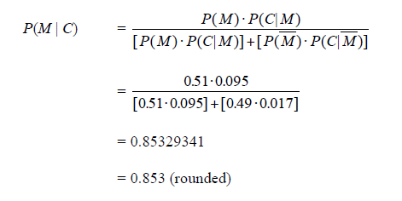
Bayes Theorem - Example
Initially we knew that the survey subject smoked a cigar, there is a 0.51 probability that the survey subject is male, however, after learning that the subject smoked a cigar, we revised the probability to 0.853.

Slide 21
#Checkpoint
Given:
A doctor knows that meningitis (M) causes stiff neck (S) 50% of the time
Prior probability of any patient having meningitis is 1/50,000
Prior probability of any patient having stiff neck is 1/20
If a patient has stiff neck, what’s the probability he/she has meningitis?

Slide 22
#Checkpoint
There is a school with 60% boys and 40% girls. The girls wear trousers or skirts in equal numbers; all the boys wear trousers. An observer sees a student wearing trousers. What is the probability this student is a girl?

Slide 23
#Checkpoint
While watching a game of football in a cafe, you observe someone who is clearly supporting Manchester United in the game. What is the probability that they were actually born within 25 miles of Manchester? Assume that:
• the probability that a randomly selected person is born within 25 miles of Manchester is 1/20;
• the chance that a person born within 25 miles of Manchester actually supports United is 7/10;
• the probability that a person not born within 25 miles of Manchester supports United with probability 1/10

Slide 24
Naïve Bayes with Many Fields
New patient:
P34=M, P61=M, BMI = H
Best guess at cancer field ?
P34 level | P61 level | BMI | Prostate cancer
High | Low | Medium | Y
Medium | Low | Medium | Y
Low | Low | High | Y
Low | High | Low | N
Low | Low | Low | N
Medium | Medium | Low | N
High | Low | Medium | Y
High | Medium | Low | N
Low | Low | High | N
Medium | High | High | Y
24

Slide 25
Naïve Bayes with Many Fields
P(p34=M | Y) × P(p61=M | Y) × P(BMI=H |Y) × P(cancer = Y)
P(p34=M | N) × P(p61=M | N) × P(BMI=H |N) × P(cancer = N)
P34 level | P61 level | BMI | Prostate cancer
High | Low | Medium | Y
Medium | Low | Medium | Y
Low | Low | High | Y
Low | High | Low | N
Low | Low | Low | N
Medium | Medium | Low | N
High | Low | Medium | Y
High | Medium | Low | N
Low | Low | High | N
Medium | High | High | Y
25

Slide 26
Naïve Bayes with Many Fields
P34 level | P61 level | BMI | Prostate cancer
High | Low | Medium | Y
Medium | Low | Medium | Y
Low | Low | High | Y
Low | High | Low | N
Low | Low | Low | N
Medium | Medium | Low | N
High | Low | Medium | Y
High | Medium | Low | N
Low | Low | High | N
Medium | High | High | Y
0.4 × 0 × 0.4 × 0.5 = 0
0.2 × 0.4 × 0.2 × 0.5 = 0.008
26

Slide 27
In practice, we finesse the zeroes and use logs: (note: log(A×B×C×D×…) = log(A)+log(B)+ …)
Naïve Bayes with Many Fields
log(0.4) + log (0.001) + log(0.4) + log(0.5) = -4.09
log(0.2) + log (0.4) + log(0.2) + log(0.5) = -2.09
27

Slide 28
Naïve Bayes in General
Essence of Naive Bayes, with 1 non-class field, is to calculate this for each class value, given some new instance with field = F:
P(class = C | Field = F)
For many fields, our new instance is (e.g.) (F1, F2, ...Fn), and the ‘essence of Naive Bayes’ is to calculate this for each class:
P(class = C | F1,F2,F3,...,Fn)
i.e. What is probability of class C, given all these field values together?
28

Slide 29
Naïve Bayes in General
Naïve Bayes Algorithm (for discrete input attributes)
Learning Phase: Given a training set S,
Output: conditional probability tables; for elements
Test Phase: Given an unknown instance ,
Look up tables to assign the label c* to X’ if
29

Slide 30
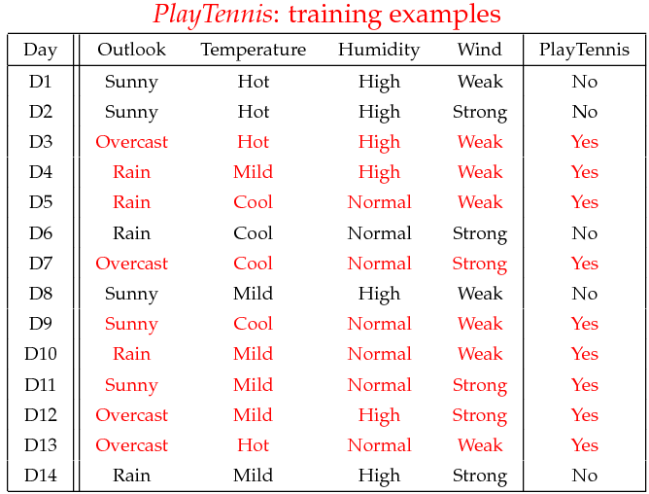
Naïve Bayes - Example
30

Slide 31
Naïve Bayes - Example
Learning Phase
Outlook | Play=Yes | Play=No
Sunny | 2/9 | 3/5
Overcast | 4/9 | 0/5
Rain | 3/9 | 2/5
Temperature | Play=Yes | Play=No
Hot | 2/9 | 2/5
Mild | 4/9 | 2/5
Cool | 3/9 | 1/5
Humidity | Play=Yes | Play=No
High | 3/9 | 4/5
Normal | 6/9 | 1/5
Wind | Play=Yes | Play=No
Strong | 3/9 | 3/5
Weak | 6/9 | 2/5
P(Play=Yes) = 9/14
P(Play=No) = 5/14
31

Slide 32
Naïve Bayes – Continuous Features
Algorithm: Continuous-valued Features
Numberless values taken by a continuous-valued feature
Conditional probability often modeled with the normal distribution
Learning Phase:
Output: normal distributions and
Test Phase: Given an unknown instance
Instead of looking-up tables, calculate conditional probabilities with all the normal distributions achieved in the learning phrase
Apply the Maximum A Posteriori rule to assign a label (the same as done for the discrete case)
32

Slide 33
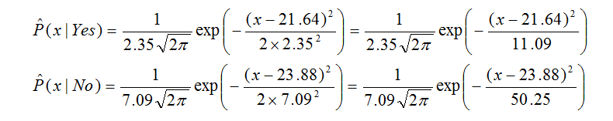
Naïve Bayes – Continuous Features
Example: Continuous-valued Features
Temperature is naturally of continuous value.
Yes: 25.2, 19.3, 18.5, 21.7, 20.1, 24.3, 22.8, 23.1, 19.8
No: 27.3, 30.1, 17.4, 29.5, 15.1
Estimate mean and variance for each class
Learning Phase: output two Gaussian models for P(temp|Y)
33

Slide 34
Conclusion
Probabilistic Classification Principle
Discriminative vs. Generative models: learning P(y|x) vs. P(x|y)
Naïve Bayes: the conditional independence assumption
Working well sometimes for data violating the assumption!
A popular generative model
Performance competitive to most of state-of-the-art classifiers even in presence of violating independence assumption
Many successful applications, e.g., spam mail filtering
A good candidate of a base learner in ensemble learning
34

